Slide 1
Open Loop (No Feedback) Op-Amps

Slide 2
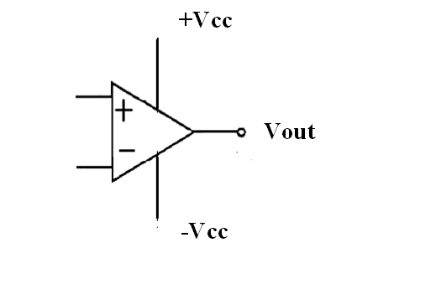
Open Loop (No Feedback)
V_{out} = A(v ⁺ - v ⁻)

Slide 3
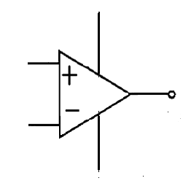
V_{out} = A(v ⁺ - v ⁻) = +- V_{sat}
If v ⁺ > v ⁻ then V_{out} = +V_{sat}
If v ⁻ > v ⁺ then V_{out} = -V_{sat}
If v ⁺ < v ⁻ then V_{out} = -V_{sat}
If v ⁻ < v ⁺ then V_{out} = +V_{sat}
+Vcc
Vsat = +Vc - 2
Vout = +-Vsat
-Vcc
Vsat = -Vcc + 2

Slide 4
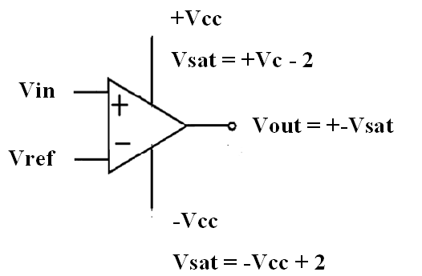
V_{out} = A(v ⁺ - v ⁻) = +- V_{sat}
If v_{in} > v_{ref} then V_{out} = +V_{sat}
If v_{ref} > v_{in} then V_{out} = -V_{sat}
If v_{in} < v_{ref} then V_{out} = -V_{sat}
If v_{ref} < v_{in} then V_{out} = +V_{sat}

Slide 5
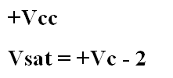
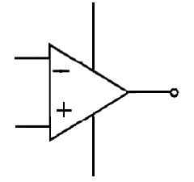
V_{out} = A(v ⁺ - v ⁻) = +- V_{sat}
If v_{in} > v_{ref} then V_{out} = -V_{sat}
If v_{ref} > v_{in} then V_{out} = +V_{sat}
If v_{in} < v_{ref} then V_{out} = +V_{sat}
If v_{ref} < v_{in} then V_{out} = -V_{sat}

